Slide 1


Webpage Layout Testing with Galen Framework

Slide 2
Agenda
Tools Used
Automation Framework Architecture
Sample Report

Slide 3
Tools And Their Significance
Selenium –Key features like Language and Framework Support, Open Source Availability, Multi-Browser Support, Support Across Various Operating Systems, Ease Of Implementation, Reusability and Integrations makes Selenium better choice for Test Automation.
Core Java - There is an abundance of readily available frameworks, plugins, APIs and libraries that supports Java for test automation.
TestNG- It’s a preferred framework of QA analysts as it allows you to generate test reports in both HTML and XML formats and enable you to group test cases easily which is not possible in Junit
Galen- Galen Framework offers a simple solution: test location of objects relatively to each other on page. Using a special syntax and comprehensive rules you can describe any layout you can imagine.

Slide 4
Tools And Their Significance
Maven(Build Tool) - Maven is a powerful project/ build management tool, which is based on the concept of a POM (Project Object Model) contains project information and configuration information for the maven to build the project like build directory, source directory, dependencies, test source directory, goals, plugin, etc.
Version control - System(Git/Bitbucket) & CI/CD(TeamCity)

Slide 5
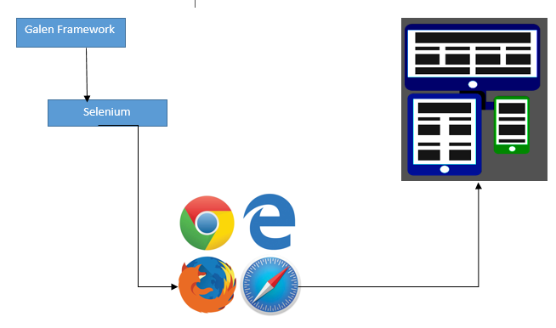
Framework Architecture

Slide 6
What is Galen Framework? Why it is Used?
It is a open source testing framework which is used to test layout of elements on web page.
Mainly useful for responsive web page elements testing.
Galen Framework is developed to check layout of web application.

Slide 7
Installation
Download jar file for Junit/ TestNG.
Maven dependency
<dependency>
<grouped>com.galenframework</groupId>
<artifactId>galen-java-support</artifactId>
<version>2.3.2</version>
</dependency>

Slide 8
gspec language
Using gspec language:
User can write different specification(s) for particular element/ object to be tested in plain English words
File extension to be .gspec
gspec file should start by specifying element/ object selector

Slide 9
Simple Feature – Positional attributes
Verifying following positional attributes:
Height/ Width exact e.g. height 25px
Height/ Width in a range e.g. width 20 to 30px
Height/ Width <,<=, >,>= e.g. width >= 50px
Near (Left/ Right/ Top/ Below) of other element/ object exact pixel
Near (Left/ Right/ Top/ Below) of other element/ object pixel range e.g.
below full_header_box 45 to 55px
Inside another element/ object e.g.
inside full_header_box 180 to 185px left

Slide 10
Simple Feature – CSS/ Text
Verifying following additional attributes:
Visible – i.e. element/ object is visible
Present – i.e. element/ object is present
Simple Feature – Groups and page section
Elements/ objects can be grouped and tested
Different sections of page or collection of pages or collection of devices can be formed

Slide 11
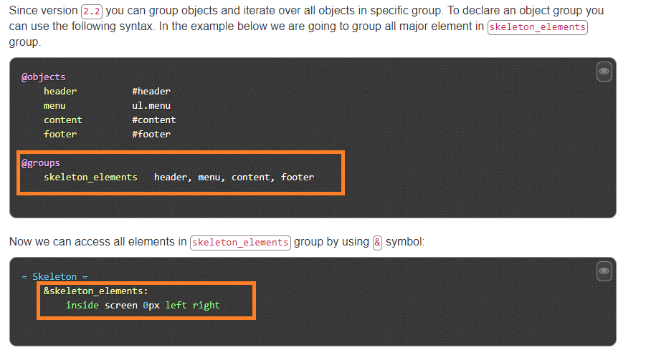
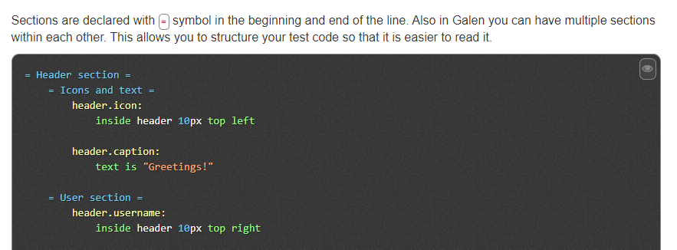

Slide 12
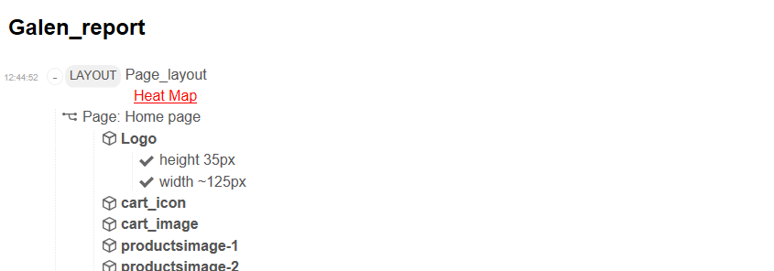
Reporting
Sample Html Report.

Slide 13
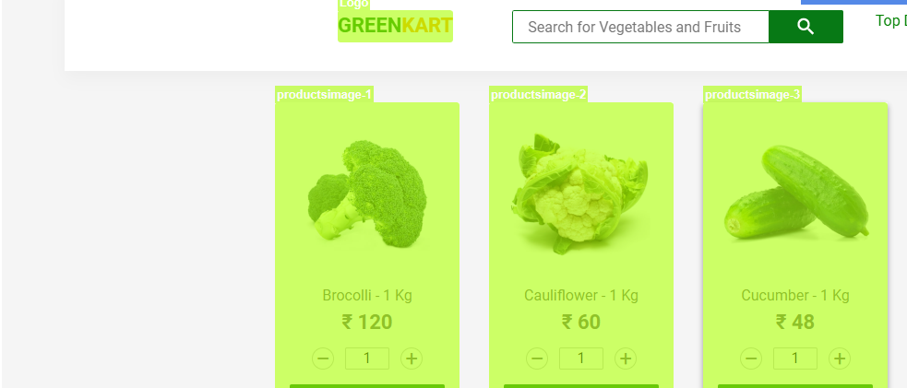
Heat Map

Slide 14
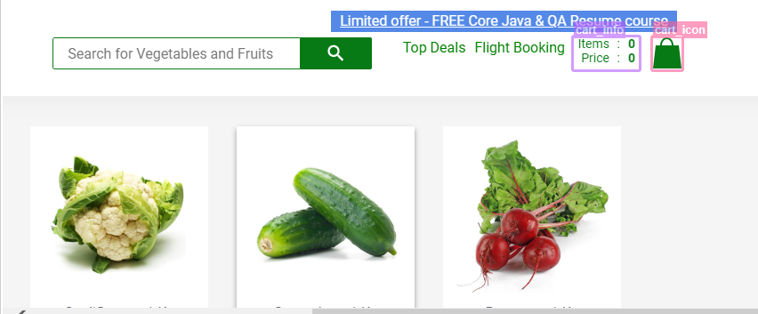
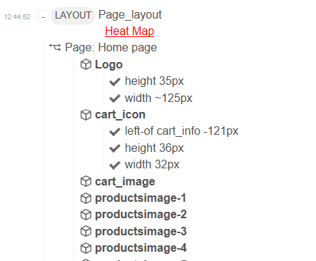
Click on Checks on Report to see located element

